Slide 1

SMART WASTE MANAGEMENT FOR METROPOLITAN CITIES
Team ID : PNT2022TMID41308
Team Lead : Vihashni G
Team Member 1 : Ishwarya S
Team Member 2 : Priyadharshini T
Team Member 3 : Sneka S
Mentor : Dr.G.Dinesh

Slide 2
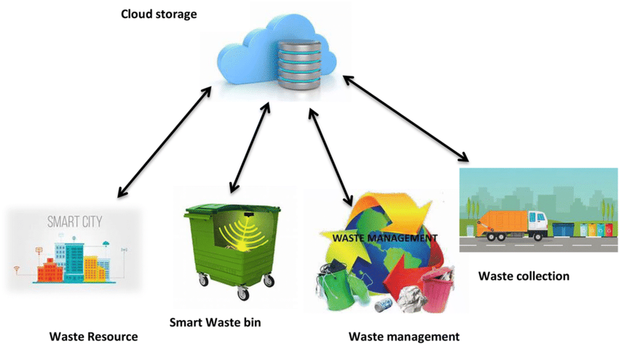
Introduction
Existing System
The system uses GPS location
Software applications
=> guided trucks
=> choose the shortest path
Short flaws
High initial cost - expensive bins (smart bins).
Sensor nodes - limited memory size.

Slide 3
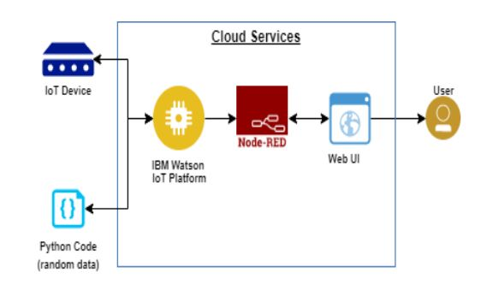
Objectives
To ensure protection of the environment through effective waste management.
To collect the level, weight and location of the bins.
To alert the user when the bin crosses its threshold level.
To send the data to the IBM Watson IOT platform (cloud service).
To send the data from the cloud service to the Node red service.
The node red dashboard is the user interface (web UI).

Slide 4
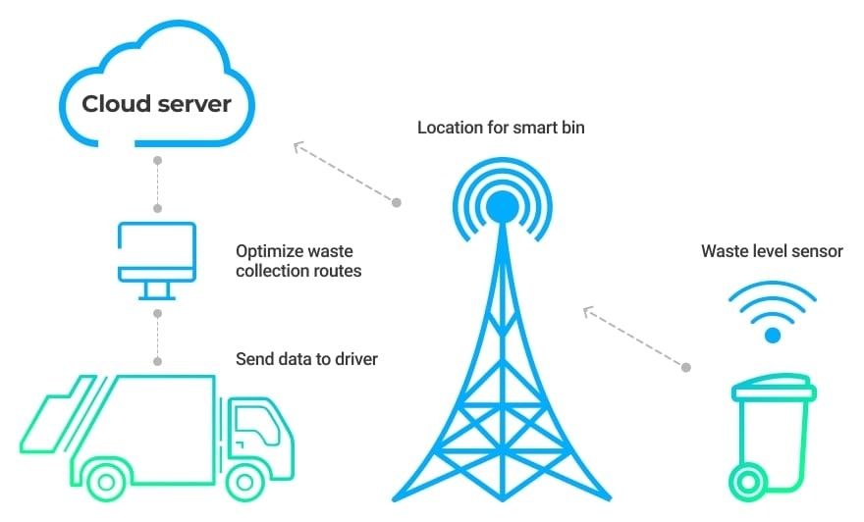
Flow Diagram
start
repeat
Check whether dustbin is full=?
No
Yes
Send message to the admin
Send cleaning vehicle for cleaning
Update status of dustbin
repeat

Slide 5


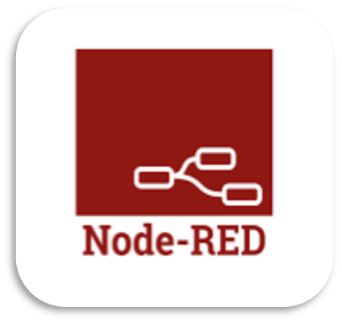

Methodologies
IBM Watson IOT Python script Node-red service Web user platform

Slide 6
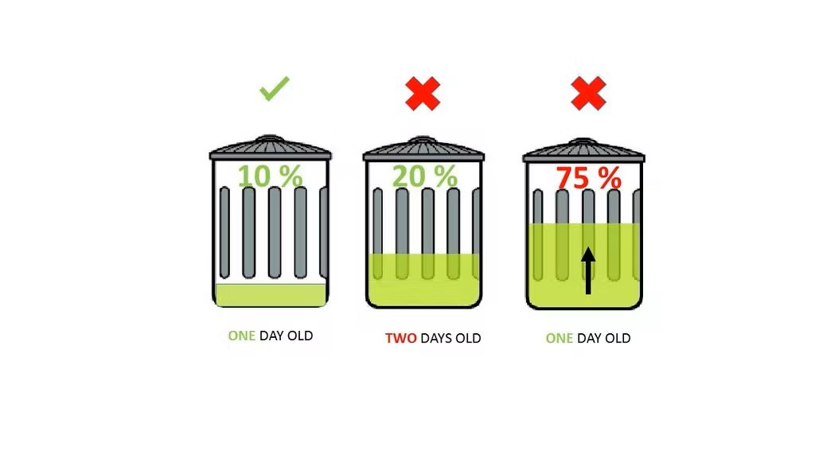
Python Script
Create a python code
To detect the level , weight & location of the bin .
Send the data to the IBM Watson using python script.

Slide 7
IBM Watson Platform
IBM Watson IoT platform acts as the mediator to connect the web application to IoT device
In order to connect the IoT device to the IBM cloud, create a device in the IBM Watson IoT platform and get the device credentials.
Configure the connection security and create API keys that are used in the Node-RED service for accessing the IBM IoT Platform.

Slide 8




Node-Red
Used for connection between IBM IOT platform and Web UI.
Data from
the bin
IBM cloud Web UI

Slide 9
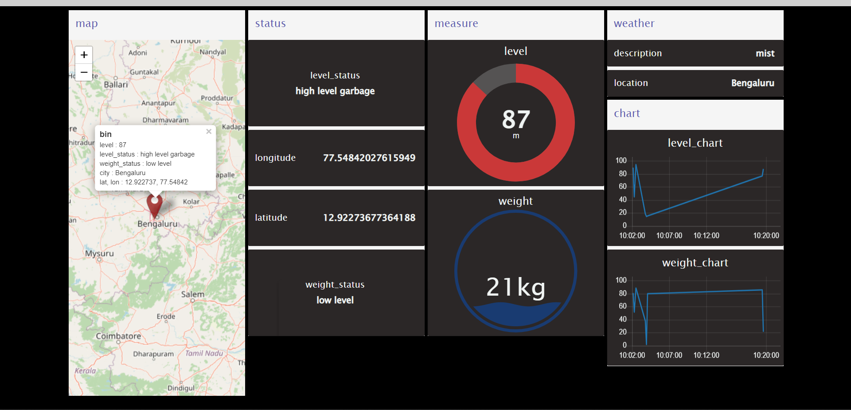
Web User interface

Slide 10
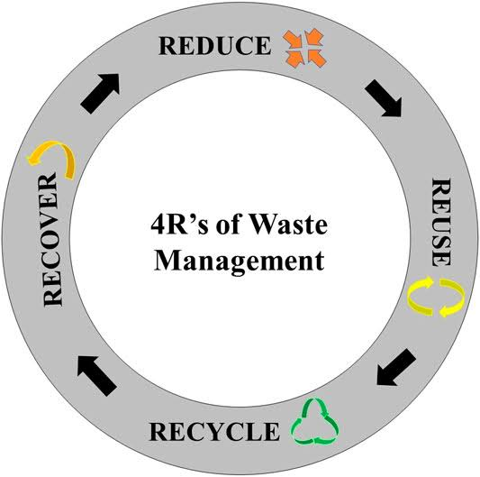
Features
Real-time waste monitoring.
Predictions for bin fullness.
Detailed database of bins.
Interactive bin map including Street view.
Empowers clean and green city programs.

Slide 11
References
Belal Chowdhury, Morshed U Chowdhury, “RFID-based real time smart waste management system.” Australian telecommunications networks and applications conference (ATNAC) (2007)
Md. Shafiqul Islam, Maher Arebey, M.A. Hannan, Hasan Basri “Overview of solid waste bin monitoring and collection system,” International conference on innovation, management and technology research (ICIMTR) (2012)
Theodoros Vasileios Anagnostopoulos and Arkady Zaslavsky, “Effective waste collection with shortest path semi-static and dynamic routing.” LNCS vol.8638, pp. 95-105, Springer (2014).
Ala Al-Fuqaha, Mohsen Guizani, Mehdi Mohammadi, Mohammad Aledhari, Moussa Ayyash, “Internet of Things: A survey on enabling technologies, Protocols and applications.”IEEE communications surveys and tutorials.1553-877x © (2015).
Kusum Lata, Shri S K Singh, “IOT based smart waste management system using Wireless Sensor Network and Embedded Linux Board.” International journal of current trends in engineering and research (IJCTER)(2016)

Slide 12
DEMONSTRATION VIDEO LINK
https://drive.google.com/file/d/1hWFRqtPmkCZo5PHA_Hu9LlqL3hGnRFyX/view?usp=share_link

Slide 13
Thank You

